Slide 1
ENG 528: Language Change Research Seminar
Sociophonetics: An Introduction
Chapter 7: Voice Quality

Slide 2
Lab Exercise # 4
I’ll put 14 soundfiles and accompanying textgrids on Moodle
You fill in all the points and labels that go in the tone tier and the break index tier
E-mail me your 14 fully labeled textgrids (nothing else, please!) by the due date

Slide 3
What is Voice Quality?
Aspects of speech that aren’t covered by segments or prosody
Configurations of the larynx/vocal folds, velum, tongue, and lips (and maybe other things) that aren’t the main contributors to segmental production
Mostly cover stretches of speech longer than one segment, often a general feature of an individual’s speech
Non-modal voice quality features are often (with good reason) regarded as pathological, but they also allow us to identify individuals by voice
Voice quality is often exploited for cartoon voices (e.g., Popeye, Marge Simpson)

Slide 4
What’s in it for us?
Speech pathologists dominate the study of voice quality
However, there’s the danger that voice qualities that are effected for social reasons can be mislabeled as pathological (does this sound familiar???) —It’s time we got on the ball!
Some of the few sociolinguistic forays into voice quality have been pretty successful

Slide 5
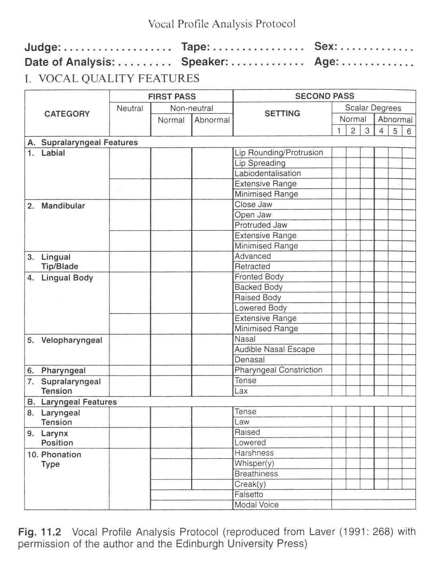
Stuart-Smith (1999) on Glasgow, Scotland
The table on the right shows the voice quality features that trained judges evaluated auditorily from recordings of Glasgow natives

Slide 6
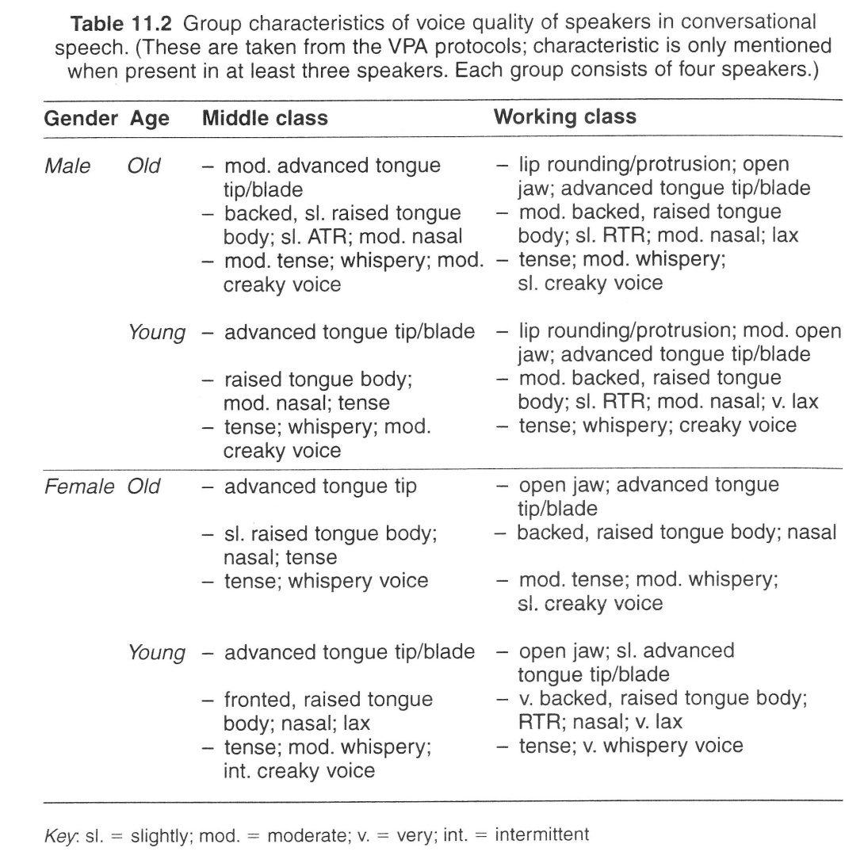
Stuart-Smith (1999): Results for conversational speech

Slide 7
Yuasa (2010)
Henton & Bladon (1985) had found that British women exaggerated the natural breathiness of their voices for social meaning
American women, on the other hand, do the opposite!
Japanese women and American men were used as control (or comparison) groups

Slide 8
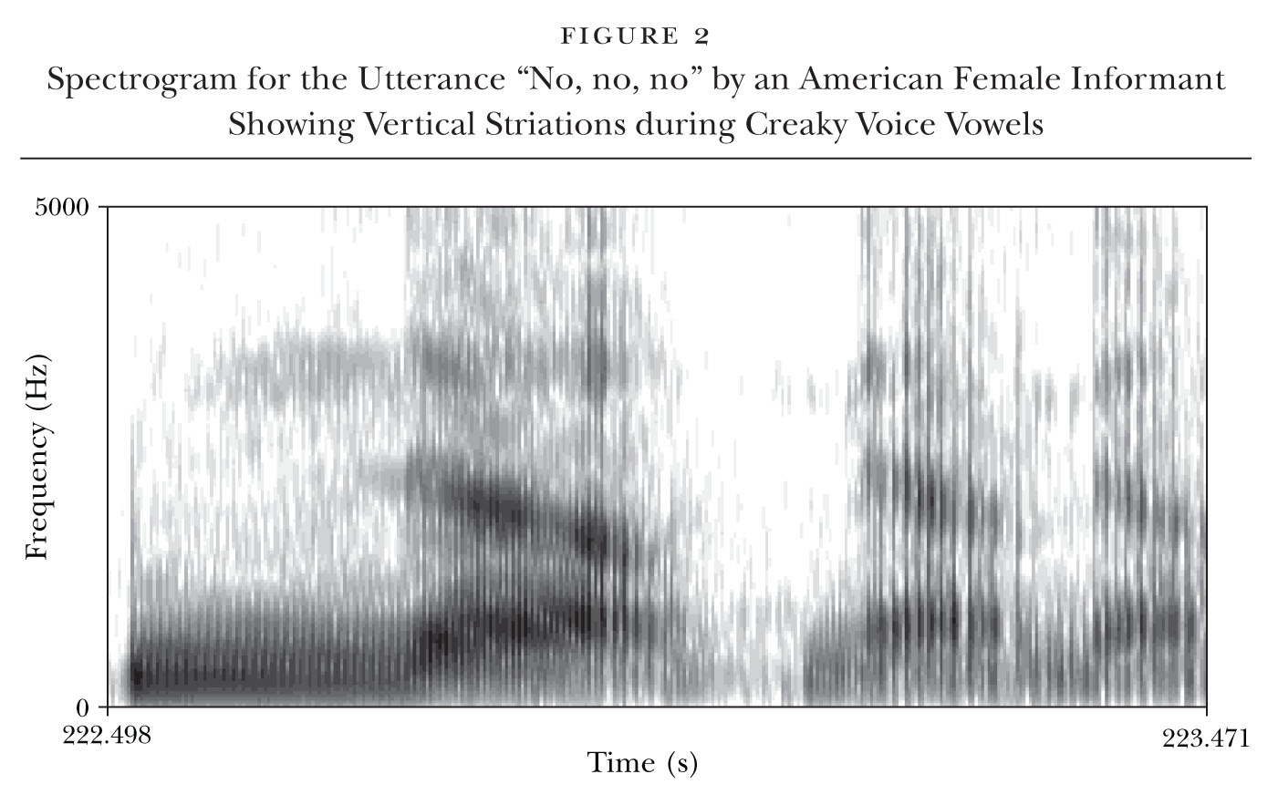
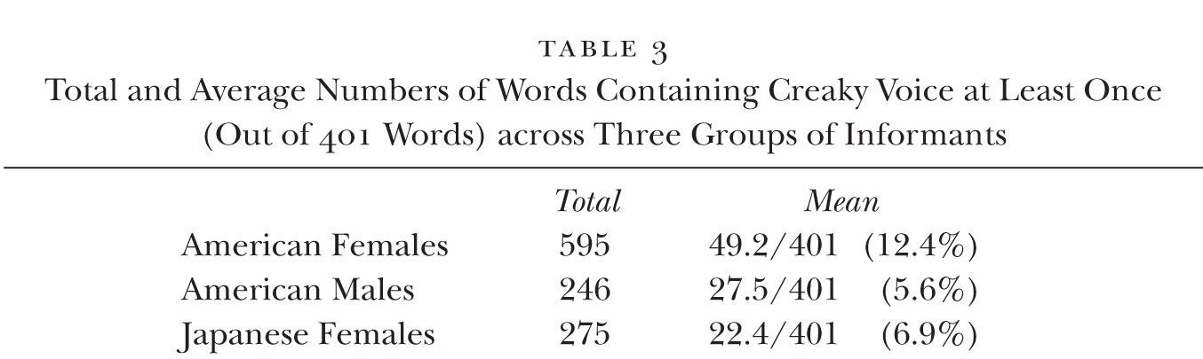
Yuasa (2010)

Slide 9
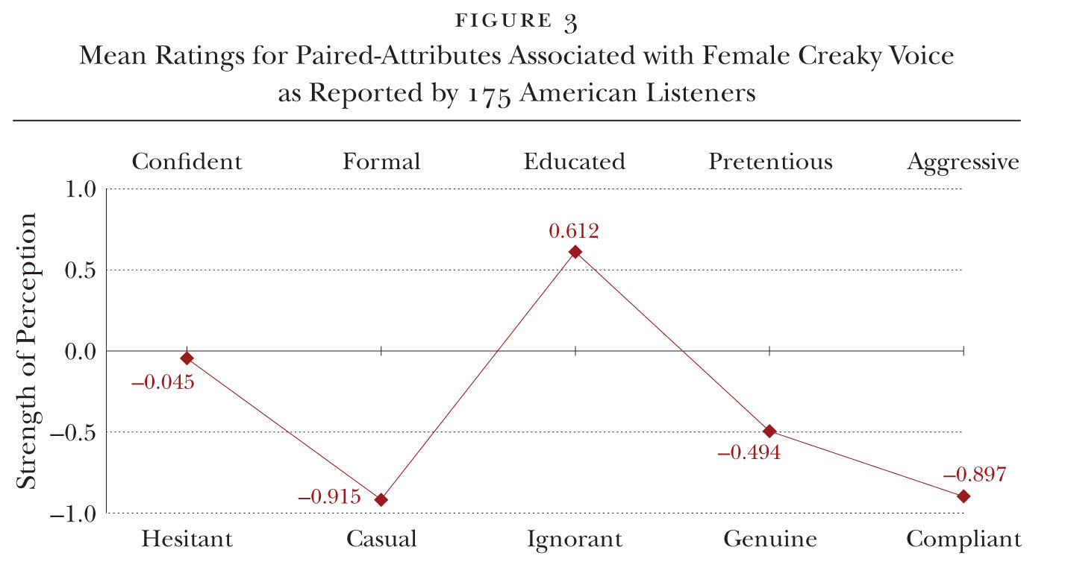
Yuasa (2010)

Slide 10
Ideally, we’d like to use instrumental analysis instead of auditory analysis.
Even highly trained speech pathologists can show low rates of agreement with each other’s assessments.

Slide 11
Basic Taxonomy of Voice Quality Features
Laryngeal features: have to do with structures inside the larynx, mostly the vocal folds
Supralaryngeal: have to do with things above (or downstream from) the larynx, including the velum, tongue and jaw, and lips, but also including larynx height (because it affects the length of the pharynx)

Slide 12
Other Considerations
Remember that:
Some unusual voice qualities occur throughout a person’s speech, while others are restricted to certain parts of utterances; either one may be salient to listeners
Voice quality is usually considered to apply only to voiced parts of speech

Slide 13
Fundamental Frequency Range
This can shade into prosody, but for the most part it’s taken to include a) F₀ characteristics that apply throughout a person’s speech and b) F₀ characteristics that are used for stylistic effect
“overall F₀” is sometimes vaguely applied to these factors
Key: range of variation in F₀
often associated with degree of emotion—e.g., excitement
standard deviation or variance of ERB-converted F0 values is a good measure of it
Register (not to be confused with stylistic register): average F₀
Also associated with certain affective states, such as nervousness or deference
Mean F₀ is a good measure of it
Difference in ERB between mean and median F₀ can be useful for interspeaker differences

Slide 14
Phonation
Commonly considered the most prototypical of laryngeal voice quality features
Creaky and breathy are familiar terms to most linguists; some other terms are less familiar
Phonation types can be associated with segments, with speaking styles, or with individuals, and apparently with dialects
Several acoustic methods are available to study it

Slide 15
Modal Voicing
It’s what is considered “normal”
Note the clearly defined vocal fold vibrations in both the waveform and the spectrogram

Slide 16
Breathy Voicing
Much of vocal fold length is open during voicing
Not the same as whispering
Vocal pulses are very well defined in waveforms but look fuzzy in spectrograms—remember why?

Slide 17
Rough Voicing
Sounds like the speaker has been coughing too much or is angry
Characterized by vocal pulses that are irregular in both frequency and amplitude

Slide 18
Creaky Voicing
You might sound like this when you first get up in the morning
Characterized by greatly slowed vocal pulsing

Slide 19
Not All “Creakiness” is the Same
Hoarseness is not creakiness, though there’s a continuum between them
Another common state is where vocal pulses alternate in amplitude

Slide 20
Spectral Features of Modal Voicing
Relatively gradual falloff of amplitude from low to high frequencies (=moderate spectral tilt)
Highest-amplitude harmonic is usually associated with F₁

Slide 21
Spectral Features of Breathy Voicing
Rapid falloff of amplitude (=high spectral tilt)
H1 (F₀) has the highest amplitude
Some high-frequency noise

Slide 22
Spectral Features of Creaky Voicing
Less rapid falloff of F₀ (low spectral tilt)
H1 (F₀) is not the harmonic with the greatest amplitude; H2, H3, or H4 has greater amplitude, and a harmonic associated with F₁ may have the greatest

Slide 23
Ratios of Harmonic Amplitudes
The most commonly used method of gauging phonation is to subtract harmonic amplitudes (since the decibel scale is logarithmic, subtraction will actually give you a ratio)
You can compute H1-H2 amplitude difference
A problem is that F₁ can get in the way, so high and low vowels may not be comparable
A solution to that is to subtract the amplitude of the strongest harmonic within F₁ from the amplitude of H1

Slide 24
Ratios of Harmonic Amplitudes: Modal Phonation
H1-H2 is usually close to zero; H1-F₁ is most often negative

Slide 25
Ratios of Harmonic Amplitudes: Breathy Phonation
H1-H2 is strongly positive; H1-F₁ is usually positive

Slide 26
Ratios of Harmonic Amplitudes: Creaky Phonation
H1-H2 is usually negative (unless H3 or H4 has the highest amplitude); H1-F₁ is usually negative

Slide 27
Jitter
Jitter is local variation in frequency of vocal pulses
Typically high for rough voicing, a little lower for creaky voicing, and much lower for modal and breathy voicing
Relative average perturbation (RAP) is the common method of measuring it, but there are other methods; RAP divides durations of three pitch periods by duration of middle one
RAP and other methods depend on distinguishing vocal pulses, either by peak picking or by autocorrelation

Slide 28
Shimmer
Shimmer is local variation in amplitude of vocal pulses
Typically high for rough voicing, a little lower for creaky voicing, and much lower for modal and breathy voicing
Amplitude perturbation quotient (APQ) is the most common method; similar to RAP, but takes amplitudes of 3-11 pitch periods
Dependent on delimiting vocal pulses
In Praat, from a spectrogram, click on “Pulses” and then on “Voice report”

Slide 29
Harmonics-to-Noise Ratio
Computes ratio of periodic to aperiodic elements in a voice
Low for rough and creaky voicing but high for modal and breathy voicing
Determining what’s periodic is a problem: several formulas are available
Background noise figures into the aperiodic part, so recording quality makes a difference

Slide 30
Cepstral Peak Prominence (CPP)
Cepstral analysis was originally designed to measure F₀ (Noll 1966)
power spectrum of signal taken using Fourier analysis
logarithm of spectrum is computed
spectrum of logarithmic function is taken, again using Fourier analysis
x-axis shows quefrency in milliseconds
y-axis shows cepstral magnitude in decibels

Slide 31
Cepstral Peak Prominence (CPP)
Raw (left) and smoothed (right) cepstra are shown

Slide 32
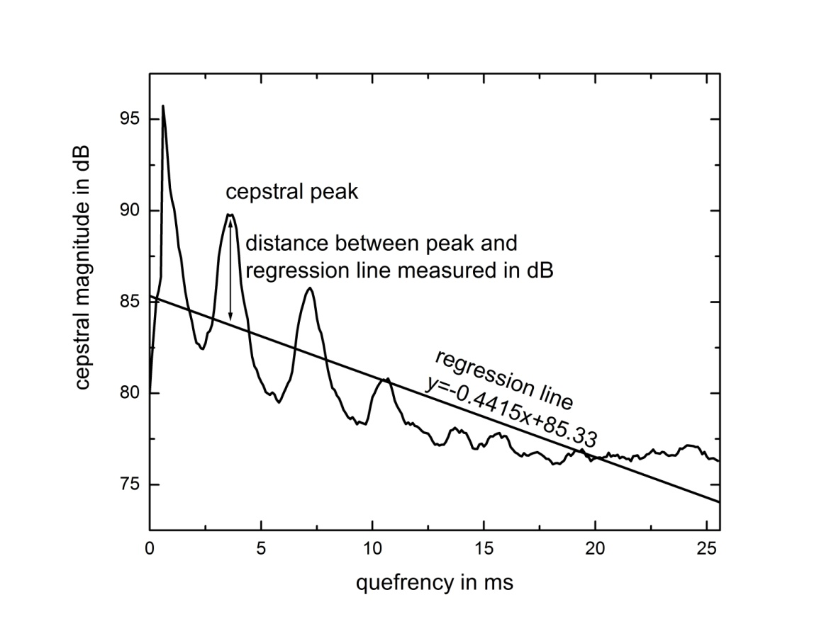
Cepstral Peak Prominence (CPP)
Hillenbrand, Cleveland, and Erickson (1994) and Hillenbrand and Houde (1996) applied cepstral analysis as a metric for determining breathiness
It works because the cepstral peak stands out less in the cepstrum of a sample of breathy phonation than one of modal phonation
The reason for that is that higher harmonics are less prominent in a spectrum of breathy phonation
Hillenbrand and his colleagues computed a regression line of the cepstrum and then measured the distance between the cepstral peak and the regression line
This was called Cepstral Peak Prominence (CPP)

Slide 33
Larynx Height
Remember all those yawning vowel measurements I made you do? That has to do with larynx height
Affects F₁ frequency and any other formants affiliated with the back cavity
Lowered larynx gives you the “football coach” voice

Slide 34
Tongue and Lip Settings
Have to do with habitual shifting of the tongue in some direction or of the lips to greater or lesser protrusion or rounding
They’re what Stuart-Smith (1999) was analyzing
They’ve always been evaluated by ear by trained pathologists
Acoustic methods are underdeveloped

Slide 35
Nasality (1)
Often mentioned as a stereotypical feature of dialects, but in such descriptions, “nasal” doesn’t usually mean anything more than “twang,” “clipped,” or “drawled”
As you know already, true nasality includes various nasal formants and antiformants
Vowel nasality can mark a following nasal consonant or it can mark phonologically nasal vowels

Slide 36
Nasality (2)
Note the locations of extra formants and antiformants

Slide 37
Measurement of Nasality: A1-P1
A1-P1 is the amplitude of the first oral formant minus the amplitude of the second nasal formant
bed, nasal setting

Slide 38
Measurement of Nasality: A1-P0
A1-P0 is the amplitude of the first oral formant minus the amplitude of the first nasal formant
bed, modal setting

Slide 39
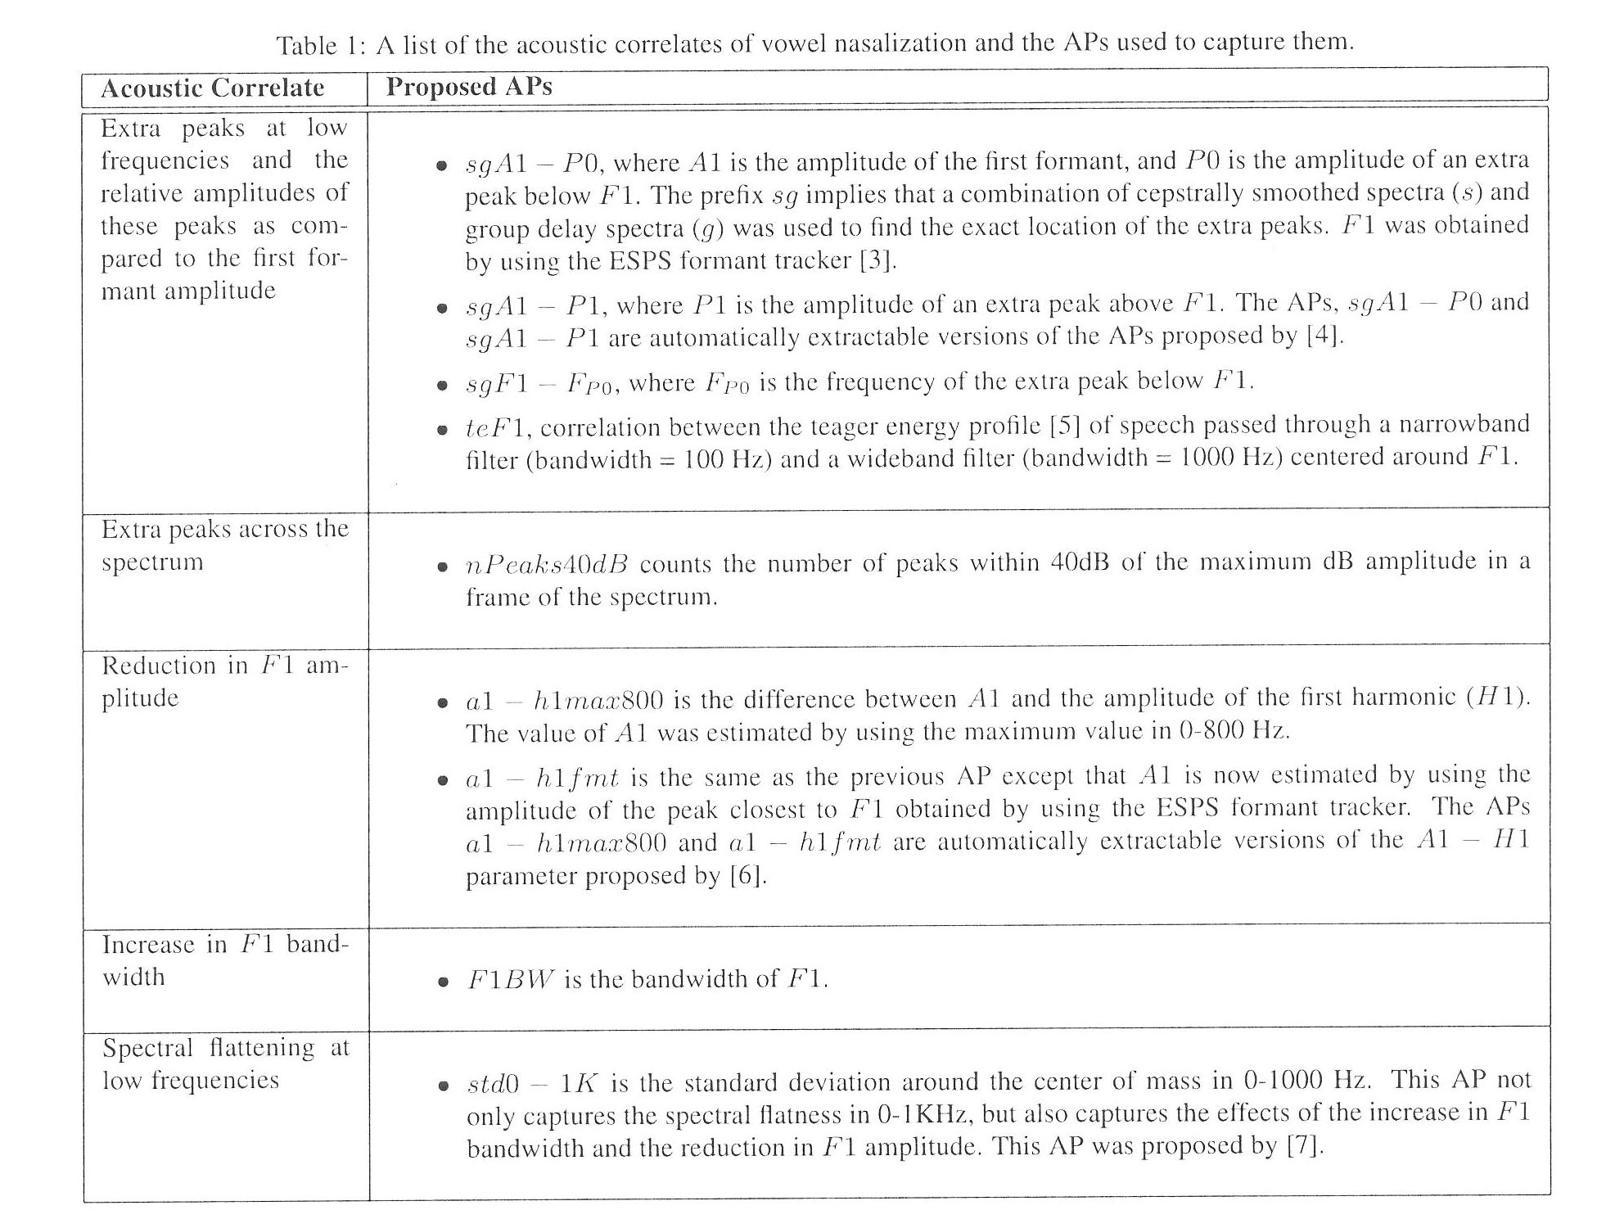
Measurement of Nasality: Pruthi and Espy-Wilson’s Battery

Slide 40
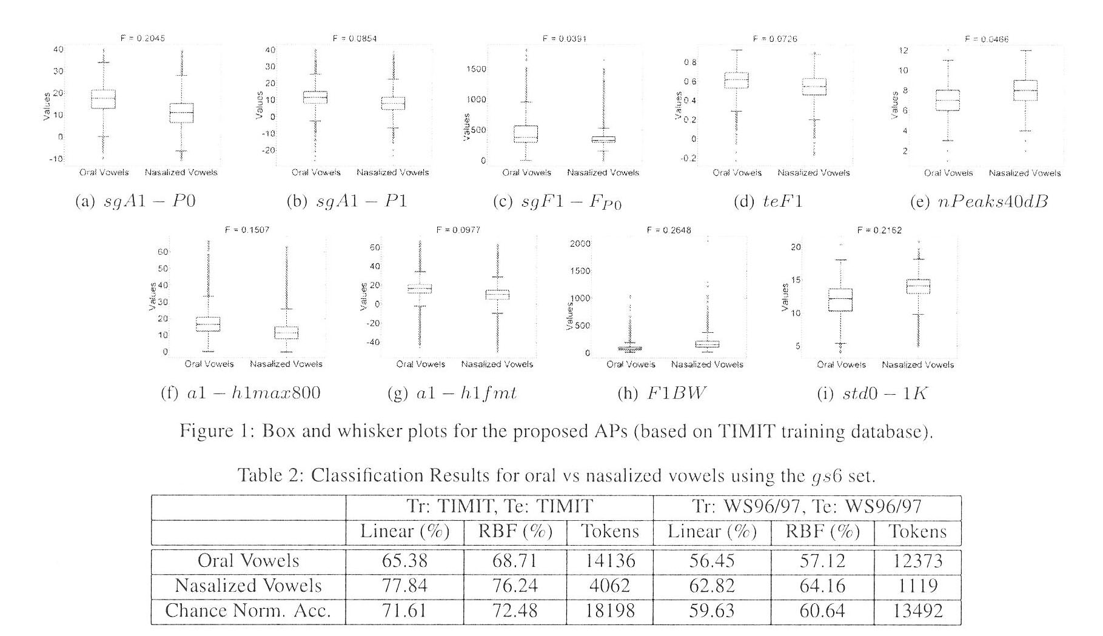
Measurement of Nasality: Pruthi and Espy-Wilson’s Results

Slide 41
Devices to Measure Nasal Sound Output
We’re not talking here about Walt sneezing
The Nasometer has a plate that rests against the upper lip and two microphones
Usually used for pathological problems such as cleft palates, but can be used for sociolinguistic work
Measures “nasalance,” which is either:
the ratio of acoustic output of the nasal cavity to that of the oral cavity (the “nasalance ratio”) or
the percentage of nasal acoustic output out of the total of both nasal and oral output (“% nasalance”)
There’s also the OroNasal system, which involves a mask

Slide 42
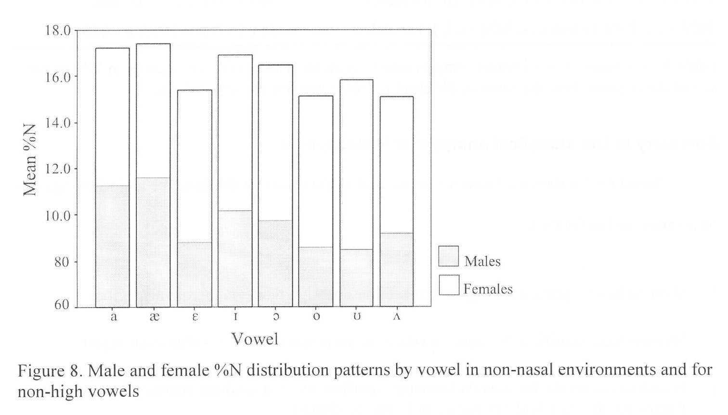
Plichta (2002)
He investigated whether nasality was associated with raised /æ/ in the Northern Cities Shift in Michigan
He used both the Nasometer and A1-P1

Slide 43
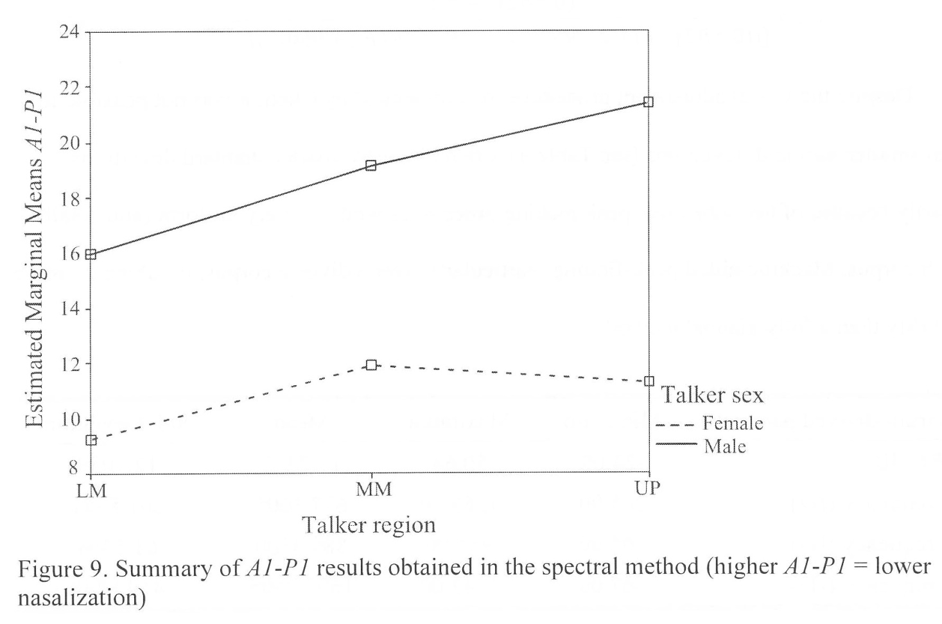
Plichta (2002)
Note the differences in A1-P1 among Lower Michigan, Mid-Michigan, and the Upper Peninsula: lower value indicates greater nasality

Slide 44
One last item: Tenseness
In voice quality, “tense” refers to overall muscular tenseness of the vocal tract
Not the same as tenseness in vowel quality!
Laver (1980) says that tense vowel quality includes creaky/harsh phonation, little vowel reduction, higher F₀, often greater loudness
Laver also says that lax vowel quality includes breathiness, more vowel reduction, larger bandwidths, some nasality
This stuff is usually evaluated auditorily by speech pathologists

Slide 45
References
The diagrams on slides 32 & 33 are taken from:
McDonald, Katie, and Erik R. Thomas. 2011. Cepstral Peak Prominence as a Method for Gauging Ethnic Differences in Phonation. Paper presented at New Ways of Analyzing Variation 40, Washington, DC, 28 October.
Other sources:
Henton, Caroline G., and R. Anthony W. Bladon. 1985. Breathiness in a normal female speaker: Inefficiency versus desirability. Language and Communication 5:221-27.
Hillenbrand, James, Ronald A. Cleveland, and Robert L. Erickson. 1994. Acoustic correlates of breathy vocal quality. Journal of Speech and Hearing Research 37:769-78.
Hillenbrand, James, and Robert A. Houde. 1996. Acoustic correlates of breathy vocal quality: Dysphonic voices and continuous speech. Journal of Speech and Hearing Research 39:311-21.
Laver, John. 1980. The Phonetic Description of Voice Quality. Cambridge: Cambridge University Press.
Noll, A. Michael. 1967. Cepstral pitch determination. Journal of the Acoustical Society of America 41:293-309.
Plichta, Bartlomiej. 2002. Vowel nasalization and the Northern Cities Shift in Michigan. Unpublished typescript.
Pruthi, Tarun, and Carol Y. Espy-Wilson. 2007. Acoustic parameters for the automatic detection of vowel nasalization. In Proceedings of Interspeech 2007, Antwerp, Belgium, 1925-28.
Stuart-Smith, Jane. 1999. Glasgow: Accent and voice quality. In Paul Foulkes and Gerard J. Docherty (eds.), Urban Voices, 203-22. London: Arnold.
Yuasa, Ikuko Patricia. 2010. Creaky voice: A new feminine voice quality for young urban-oriented upwardly mobile American women? American Speech 85:315-37.

