Slide 1
ENG 528: Language Change Research Seminar
Sociophonetics: An Introduction
Chapter 5: Vowels (Continued)
Lindblom (1963), Undershoot

Slide 2
Third Laboratory Assignment
From any interview consisting at least partly of conversation, choose a diphthong and measure at least 25 tokens of it. (You’ll need a diphthong with plenty of tokens, so don’t pick /oi/.)
Measure the duration of the entire diphthong and formant values for the nucleus and/or glide.
Using Origin, plot the duration of the whole diphthong on the x-axis and F₁, F₂, and, if you like, F₃ of either the nucleus or the glide on the y-axis. Include regression lines. You may make different plots or one plot showing all the formants (you may need a logarithmic scale for that). This has to be in Origin because I want everybody to learn how to use it.
Print out the plot(s) and turn them in on October 24.

Slide 3
Undershoot: Definitions
Target: the point that the speaker “intends” to reach (controversy: is it an articulatory or acoustic target?)
Undershoot: failure to reach the target
Because of short duration
Because of weak stress
Other reasons? (I.e., can some sounds be specified as being given less effort to reach their targets? Do some languages or dialects show more undershoot than others?)

Slide 4
More Definitions
Coarticulation: overlap of segments
Assimilation: a segment becomes more like a neighboring segment
Truncation: part of a segment, such as a steady state or a glide, is lopped off when the duration is shorter
Compression: no lopping off, but all the components are squeezed into a shorter time frame
Reduction: weaker articulation; for vowels, it means becoming more schwa-like. Two senses:
Phonological: predictable alternation between a full vowel and schwa; no intermediate realizations
Phonetic: vowel is on a gradient between full realization and schwa, with any intermediate realization possible

Slide 5
Plotting Undershoot
Generally, you plot the duration of something (generally the whole vowel) against a formant measurement
Example for /a/ in K’iche’:

Slide 6
Undershoot plots to tease out phonological distinctions
Here’s what figure 5.28 is supposed to look like:

Slide 7
Degree of Undershoot can Differ:
/a/ vowels in three languages
Turkish
Slope=1.655
Am. English
Slope=-0.04101
K’iche’
Slope=1.262
Am. English, long outliers removed
Slope =0.08185

Slide 8
Factoring Out Coarticulation
Measure formants at vowel onset or offset
Measure formants at some point within the vowel
Subtract within-vowel formant measurement from onset~offset formant measurement
Use that difference to normalize for coarticulation

Slide 9
Lindblom (1963)
“Spectrographic Study of Vowel Reduction”
this is the paper that launched experimental phonetics as a science—it provided a testable hypothesis
looked at the effects of duration on Swedish short vowels
had subjects say vowels in b_b, d_d, and g_g contexts in the carrier phrases så är det ___ and __ är det så
subjects had metronome played into their ears so that they said the words at different speeds

Slide 10
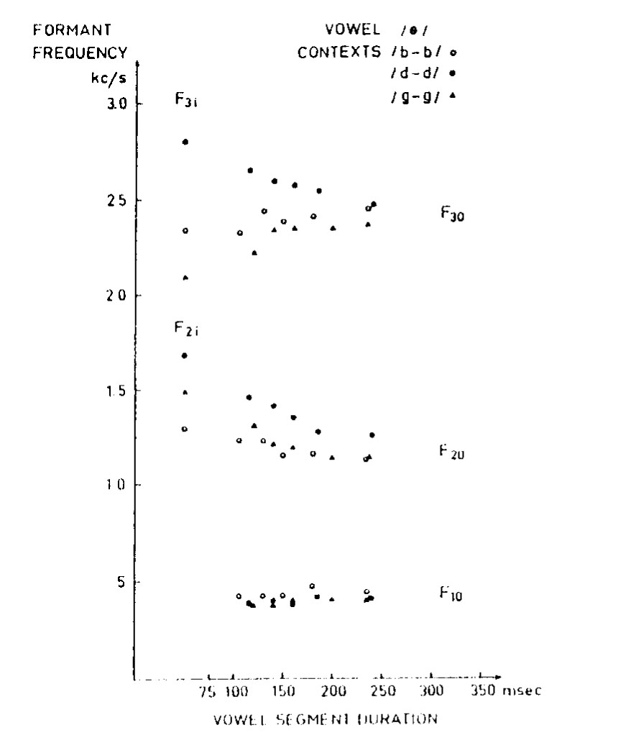
Lindblom (1963)
“Spectrographic Study of Vowel Reduction”
duration did have an effect—vowels became closer to their offset values at short durations
the results suggested that each vowel phoneme has a target that doesn’t vary—the consonantal context doesn’t affect the target
p. 1780: He says that the undershoot pattern isn’t corrected by speakers and “it presupposes that the listener is able to correct for coarticulation effects”

Slide 11
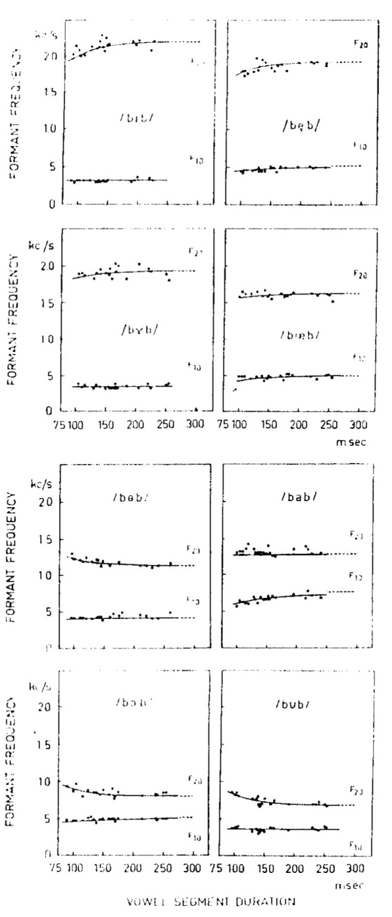
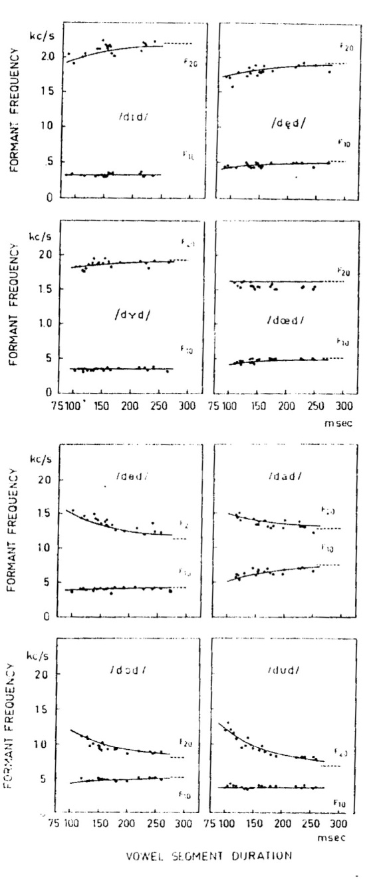
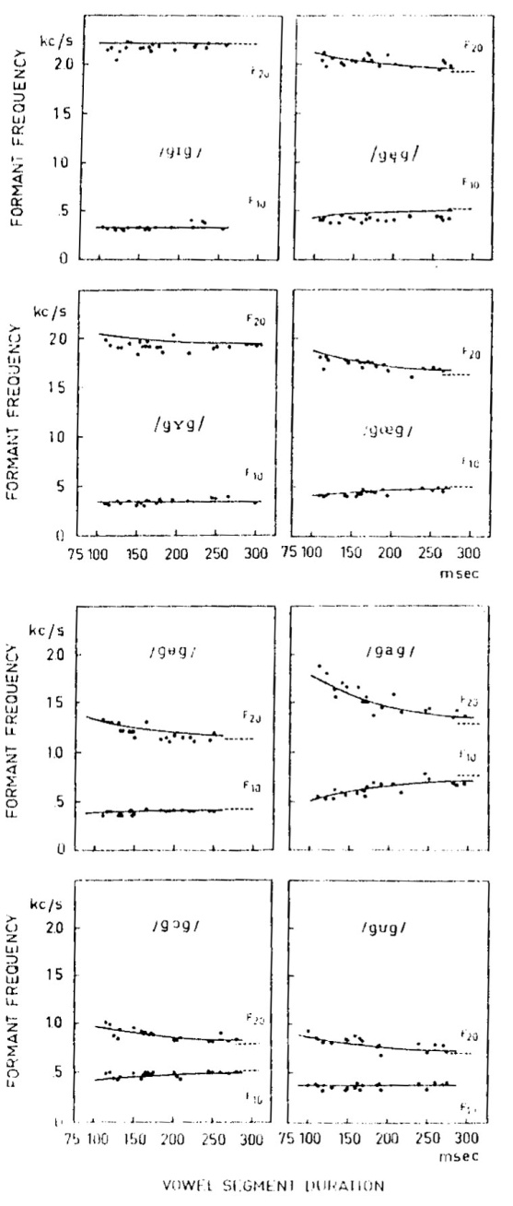
Lindblom (1963)
“Spectrographic Study of Vowel Reduction”
b_b
d_d
g_g

Slide 12
Reactions to Lindblom (1963)
In subsequent years, several other researchers found that a number of other factors besides simple duration influenced the degree of undershoot:
Stress (possibly a stronger effect than duration—see Harris 1978, Language and Speech 21:354-61)
Speaking style—research opportunities for sociolinguists?
The particular vowel phoneme
The particular language (presumably, that could mean dialects vary, too—opportunities for sociolinguists)
The particular speaker (more opportunities for sociolinguists)
In response, Lindblom (1990) developed his “H&H” theory, which says that speakers vary their clarity of speech in response to the needs of their addressees

Slide 13
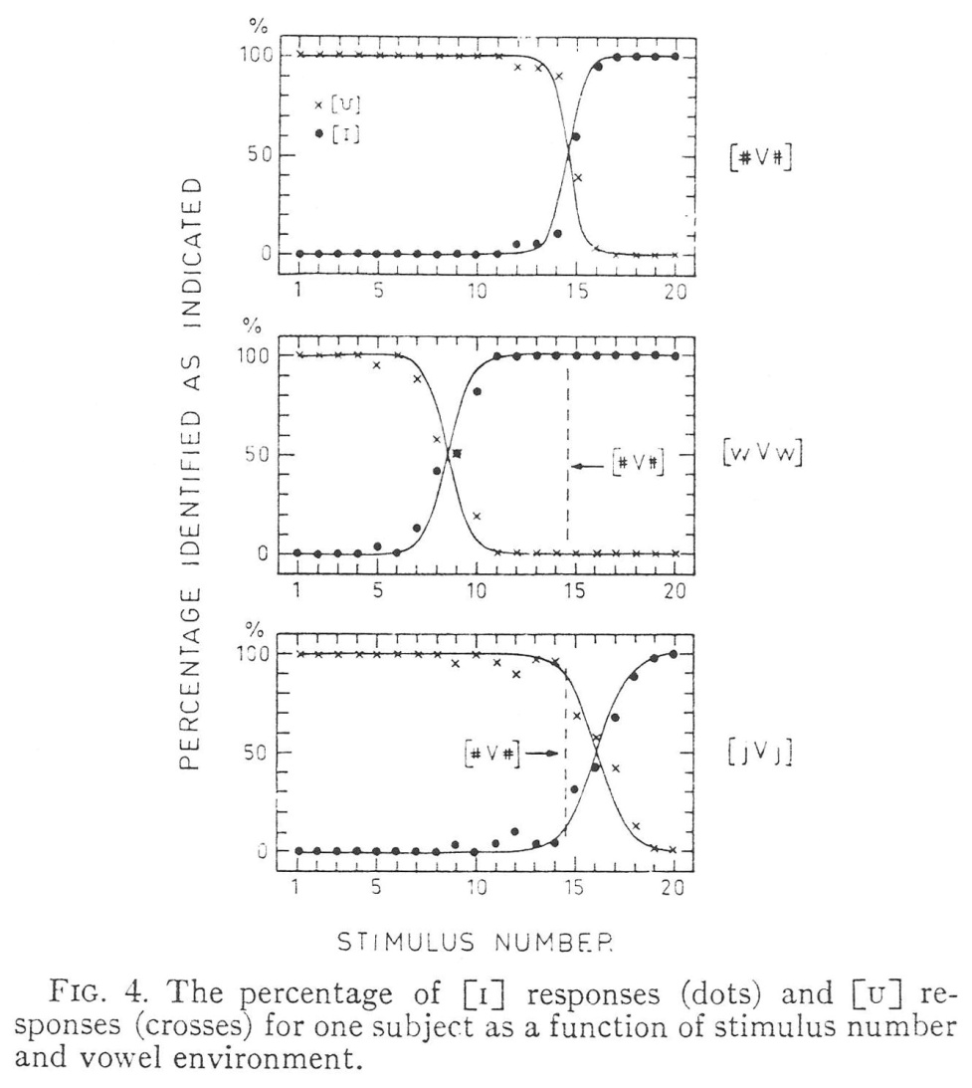
Perception and Undershoot
Lindblom & Studdert-Kennedy (1967) found that listeners’ perception compensated for coarticulation
Perceptual boundaries between // and // shifted depending on the context, in a compensatory pattern
This is the same process that Ohala (1989, 1993) later called “corrective rules”
They also noted that diphthongal glides don’t have to reach their targets because listeners expect to hear them undershot (i.e., truncated)

Slide 14
Conditioned Vowel Shifts
Occur as a result of coarticulation that, at some point, isn’t corrected for perceptually and thus is reanalyzed by language learners
In American English, conditioned vowel shifts are most common before /r/, /l/, nasals, and palatals (from anticipatory coarticulation)
Perseveratory shifts are less common, though note what happened to short /æ/ after /w/ in Early Modern English
What coarticulatory effects on vowel formants would you expect from each of those kinds of consonants?
Here’s a vowel plot for a female speaker from southeastern Ohio. What conditioned vowel shifts appear in her speech? What secondary developments did the conditioned shifts allow?

Slide 15
Discussion Question
How might difference in the degree of undershoot take on social meanings? What social meanings could they index, both for inter-speaker variation and for stylistic variation?

Slide 16
Fun with Vowel Plots

Slide 17
Today’s lab demo
Use of Origin for plotting
If you know what you’re doing with it, it’s versatile and can make esthetically better plots than programs whose primary purpose is something else

Slide 18
References
Harris, Katherine S. 1978. Vowel duration change and its underlying physiological mechanisms. Language and Speech 21:354-61.
Lindblom, Björn. 1963. Spectrographic study of vowel reduction. Journal of the Acoustical Society of America 35:1773-81.
Lindblom, Björn. 1990. Explaining phonetic variation: A sketch of the H&H theory. In William J. Hardcastle and Alain Marchal (eds.), Speech Production and Speech Modelling, 403-39. Dordrecht: Kluwer.
Lindblom, Björn E. F., and Michael Studdert-Kennedy. 1966. On the rôle of formant transitions in vowel recognition. Journal of the Acoustical Society of America 42:830-43.
Ohala, John J. 1989. Sound change is drawn from a pool of synchronic variation. In Leiv Egil Breivik and Ernst Håkon Jahr (eds.), Language Change: Contributions to the Study of its Causes, 173-98. Berlin/New York: Mouton de Gruyter.
Ohala, John J. 1993. Coarticulation and phonology. Language and Speech 36:155-70.

